Slide 1

Farming Assistance System
Team Members : Team Mentor :
Yash Raj Vishal Soni
Reema Kumari
Gaurav Mohanty
Harshit Joshi
Manoj Kumar M

Slide 2

Objectives
Abstract
High Level Design Diagram
Use Case Diagram
Sequence Diagram
Technology Used
Project Execution
Services
Modules

Slide 3
Abstract
This is a web based application to help the farmers working with the motive of greater profitability by direct communication between farmer to supplier and supplier to farmer.
This integrated system contains the Farmer component ,the Supplier component and the Admin component.
It provides an option of login to farmers and communicates to respective suppliers.
Farmers are notified whenever suppliers publish an advertisement or offer on website through SMS message.
The farmers may also have an option to submit their grievances and complaints to respective dealers or authorities using their farmer login on a separate complaints page and authorities will get access to that page regularly using their login id and passwords.

Slide 4
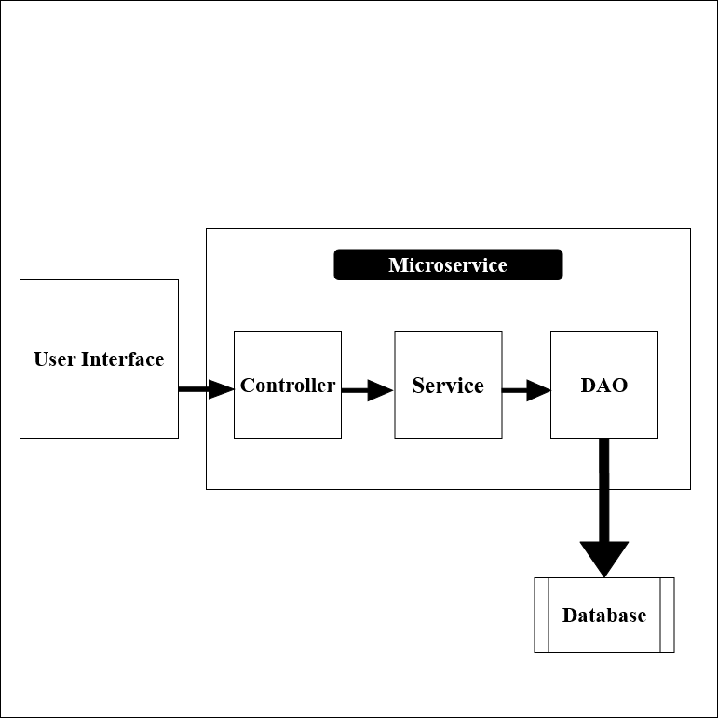
High Level Design Diagram

Slide 5
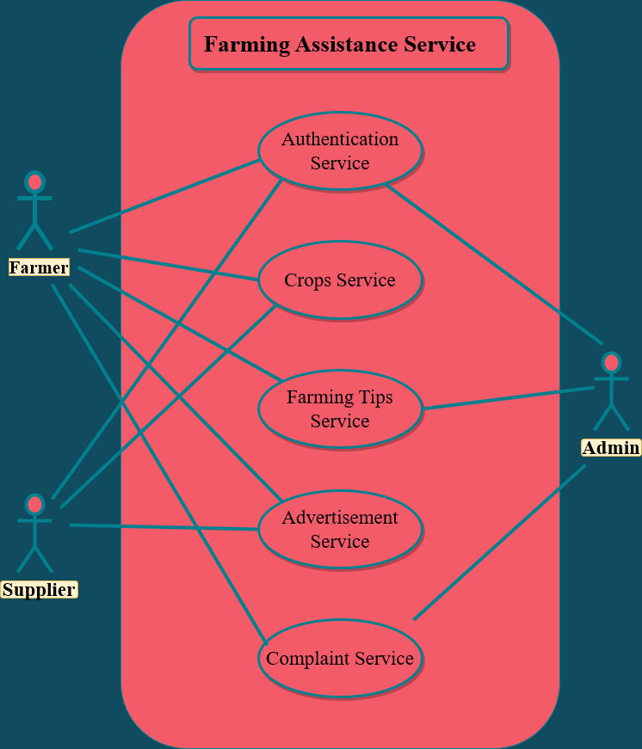
Use Case Diagram

Slide 6
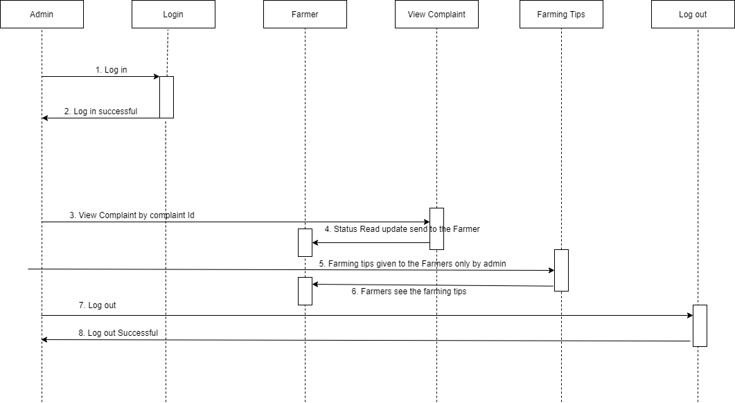
Sequence Diagram (Admin)

Slide 7
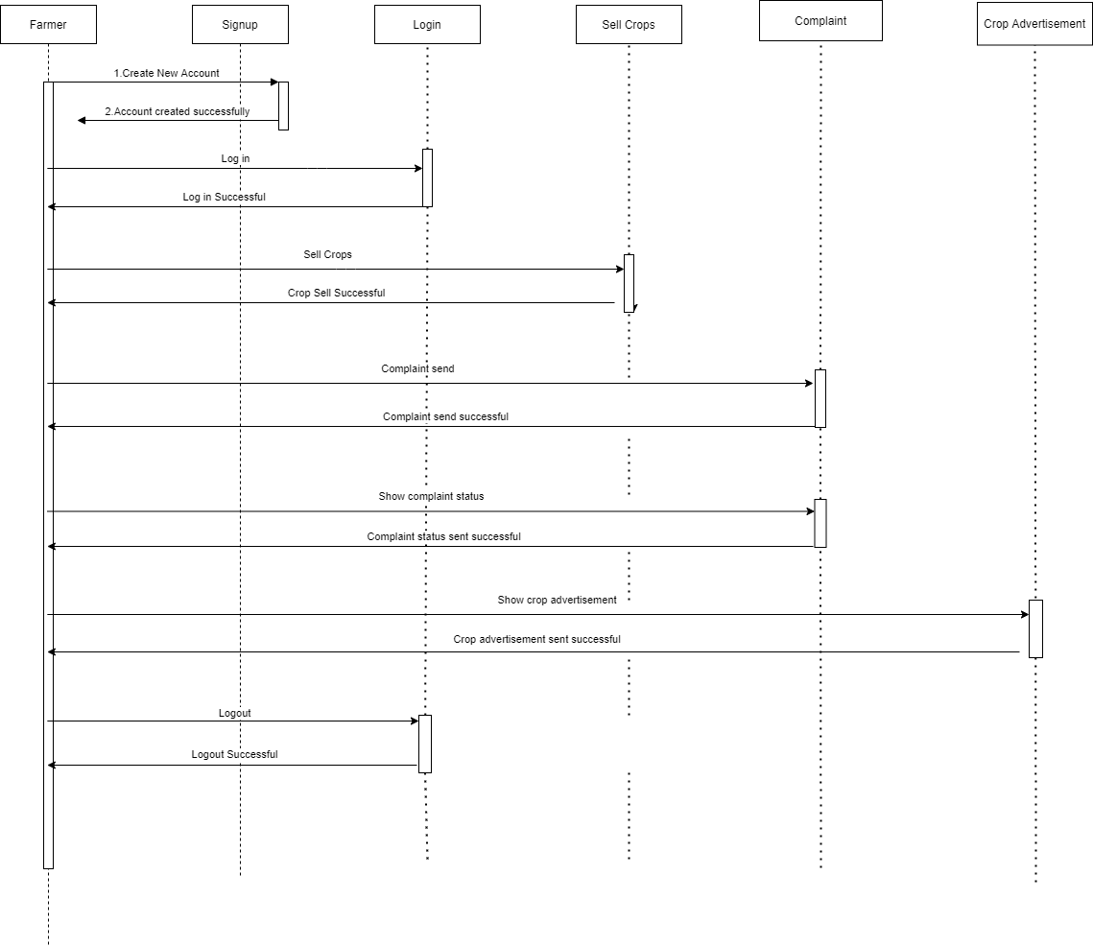
Sequence Diagram (Farmer)

Slide 8
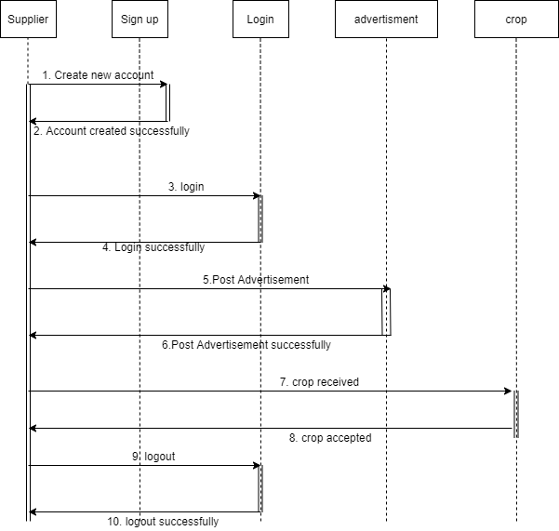
Sequence Diagram (Supplier)

Slide 9
Technology Used
HTML
CSS
JAVASCRIPT
ANGULAR 6
JAVA 8
Spring Boot/Micro services
Spring Security (JWT)
Junit 5
Postgresql 11
JPA
Maven 3.6

Slide 10
Project Execution
Authentication Service
Farming Tips Service
Advertisement Service
Crops Service
Complaint Service

Slide 11
Authentication service
Farmers and Suppliers can login into the system with their login credentials.
New Farmers and Suppliers can sign up into the system.
Farmers and Suppliers can update or delete their account.
Admin can login into the system with their credentials.

Slide 12
Farming Tips Service
Admin can add farming tips for the farmers.
Admin can update and delete the farming tips.
Farmers can view the farming tips.

Slide 13
Advertisement Service
Supplier can add an advertisement for the farmers.
Farmers will get a notification through SMS.

Slide 14
Crops Service
Farmers can add crops to sell.
Suppliers can update the added crops by farmer to (accept/reject) if all the suppliers requirements are satisfied.

Slide 15
Complaint Service
Farmers can add/submit their complaints.
Admin can view the complaint added by farmers.
Admin can update the complaint to read/solved.

Slide 16
Modules
Admin
Farmer
Supplier

Slide 17
Thank You

